Slide 1
*Back to basics – Sales Training *
with Belinda Amis Wheaton

Slide 2
Todays webinar
Part 1:
One hour
5 minute break – I will read any questions and address after the break ☺
Part 2:
One hour
Ps you may see a dog, a child or both drift past in the background due to stage 4 restrictions in Victoria

Slide 3
Back to basics
Who LOVES sales? (Psssttt… it’s ok to say no!!)
Who loves motivating and inspiring woman to become fitter, faster, leaner, stronger? (Quite sure this is a resounding yes )

Slide 4
Cancels, growth and new member targets
How?
Cancels + desired growth = Sales target
Why?
Achieve business objectives and motivate the team
When?
An annual calendar can be tweaked month to month
*All team members should understand these monthly targets
* These particular targets are just three of many monthly targets

Slide 5
Superstar traits
High level of focussed activity
Genuine
Follow up
Seeks opportunity
Continuous improvement

Slide 6
Todays plan..
Improving:
Call volume (how hard did we try on the phone?)
Contact to appointment ratio (how effective were we on the phone?)
Show ratio
Close ratio

Slide 7
Getting started…
Product
Fernwood are the leaders in woman's health and wellness clubs.
How well do you know your club?
Systems.
Among other Fernwood systems, becoming familiar with Exerp, the intranet and Velpic will be a huge advantage.
Standard Operating Procedures.

Slide 8
Let’s get started..
Daily phone calls

Slide 9
Let’s talk call volume..
Aim: To SPEAK TO (a contact) as many prospects as possible.
If call attempts are 60 for a shift, contacts may be 12
If call attempts are 90 for a shift, contacts may be 18
If call attempts are 120 for a shift, contacts may be 24
With a contact to appointment ratio of 25%, you may see 3, 4.5 or 6 appointments. How many appointments would you prefer?
Keeping our call volume high gives us greater opportunity to book more appointments.

Slide 10
The journey of a lead
Daily Exerp calls
Understanding the journey of each lead is important.
A new enquiry will automatically be moved through 6 calls in four days and then weekly calls.
There are many different journeys a lead can take.
Visit Velpic for more information.

Slide 11
Sales statistics on contact points
48% of sales people follow up with a prospect
25% of sales people make a second contact and stop
12% of sales people make 3 contacts
ONLY 10% of sales people make more than 3 contacts
HOWEVER…
2% of sales are made on the 1st contact
3% of sales are made on the 2nd contact
5% of sales are made on the 3rd contact
10% of sales are made on the 4th contact
80% of sales are made between the 5th – 12th contact

Slide 12
Understanding each call section
Unassigned = web leads/fresh leads to be assigned
Open = today’s scheduled calls
(black leads only that need follow up today)
On hold = your scheduled future calls
(black leads only need follow up as they are the second call for the day)
Pending = current & future appointments
Closed = not interested
Overdue = calls in the red
Touch calls that are in black, not faded grey as they represent future calls.

Slide 13
Your daily call flow could start with..
Unassigned
Open
On hold
Over due
Don’t forget to make your new member calls (post sign up calls) as they are a great opportunity to get some new leads.

Slide 14
Daily call projects..
Depending on your clubs lead generation, your daily Exerp calls may not be enough to book the required amount of appointments.
Daily project calls
Past member calls
Birthday calls

Slide 15
How long should we spend on the phone?
Working from Exerp, you could possible expect to take 1 hour to complete 25 calls with good outcomes
Working off call lists can be quite quick and number expectations here may be 40 per one hour.
Spending 2 – 4 hours a day on the phone in club is very common and completely necessary.
This could be a mix of two hours in Exerp and two hours on a project. Several team members can contribute to this outcome.
It is the appointments that we are searching for. Another way to view the time spent on the phone is it will take as long as it takes to achieve the appointment target.

Slide 16
Contact to appointment ratio
Fernwood standard
25 – 33%
What is yours?
Number of appointments divided by number of contacts x 100
3 divided by 9 = .33 x 100 = 33 percent contact to appointment ratio
Improving your clubs contact to appointment ratio even marginally could mean an extra one to two appointments per day. This could easily become one extra new member per day. Across just 20 sales days that is an extra 20 sales a month.
Learn how to track your ratio daily and set yourself a daily challenge!

Slide 17
Tracking activity
Why?
- Sales activity should be congruent to the desired outcomes.
When?
- Daily ☺
How?
- Training & role play greatly assists with the how.

Slide 18
What activity should be tracked daily?
A basic shift slip would include detail such as:
length of shift?
tours?
sales?
leads and where they came from?
call attempts?
contacts?
appointments?
See intranet for a template

Slide 19
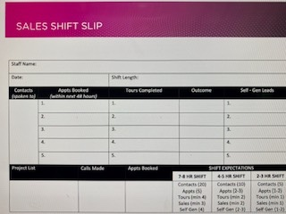
Shift slip

Slide 20
The shift slip contains a place to track lead generation..
Point of sale referrals
Outreach
Walk the floor
Referral stands
New member calls
Don’t forget to qualify your leads.
We all help to generate leads every day.
What is your plan? Today, this week? This month?

Slide 21
Tips and tools
The art of a conversation
2 ears, one mouth
Urgency
Quality of lead
Don’t give too much over the phone
Build rapport before diving in to appointment setting
Take control of the conversation
Direct the appointment where you want it to go
If someone doesn’t want to hear from us they will tell us – keep going!!

Slide 22
Outbound call
L - Let them know who you are, where you’re from and the reason for your call. Gain their interest.
E - Do you mind if I ask are you doing any Exercise at the moment?
A - When you get started with us, what are you wanting to Achieve?
D – Do mornings, afternoons or evenings suit you best?
Closing
Do you know exactly where to find us?
Would you like to bring a friend?
Are you planning on doing a workout when you come down?
On line GTKY
Head to reception, introduce yourself and we will be ready and waiting.

Slide 23
Inbound
Are you a member at our club?
L – Are you Living or working close by?
E - Do you mind if I ask are you doing any Exercise at the moment?
A - When you get started with us, what are you wanting to Achieve?
D – Do mornings, afternoons or evenings suit you best?
Closing
Do you know exactly where to find us?
Would you like to bring a friend?
Are you planning on doing a workout when you come down?
On line GTKY
Head to reception, introduce yourself and we will be ready and waiting.

Slide 24
Show ratio
Fernwood benchmark 60 – 70%
What is your clubs show ratio?
Improving your clubs show ratio even marginally could mean an extra one to two new member per day.
Imagine what could happen if the ratio is improved substantially!!

Slide 25
Show ratio
Tips and tools:
Book within a 48 hour period
Strong confirmation (phone call as well as SMS)
Getting prospect to complete GTKY
Conversation when appointment booked

Slide 26
Lets take a break…
See you in 5 minutes

Slide 27
Welcome back!!
Now we have sooooo many appointments, how do we make sure we maximise every opportunity and help these women get started?

Slide 28
Suitable for sales appointments or walk ins
Appointments to be booked on the half hour and double bookings acceptable due to show ratios.
Meet and greet – 2 minutes
Needs analysis – 6 to 10 minutes
Tour – 6 to 7 minutes
Price presentation – 3 minutes
Overcome any objections if they exist and close – 3 minutes
At the 25-minute mark, we should be at the stage of the prospect agreeing to get started. (aim for no sales to be less than 20%)
________________________________________________________
Point of sale referrals – 5 minutes.
Housekeeping – This may take up to 20 minutes and include things such as: Membership paperwork, book appointments, 24/7, health and safety etc.

Slide 29
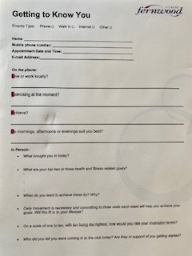
Getting to know you

Slide 30
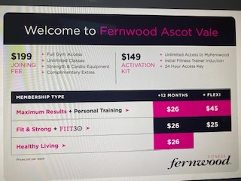
Price presenting

Slide 31
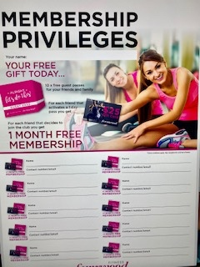
Don’t miss this golden opportunity

Slide 32
Close ratio
Fernwood benchmark?
What is your clubs close ratio?
Improving your clubs close ratio even marginally could mean an extra one to two new member per day.
Imagine what could happen if the ratio is improved substantially!!

Slide 33
Hope you enjoyed todays refresher!!
Did we achieve our objectives? Can you improve?
Call volume (how hard did we try on the phone?)
Contact to appointment ratio (how effective were we on the phone?)
Show ratio
Close ratio
Don’t forget to register to Ahead of the Curve webinar with Di Williams next week as she speaks with three franchisee’s who share information on how they have grown their clubs since re opening.
Good luck everyone ☺

